Slide 1
Prevention of cyber-attack using Intrusion detection system with Machine Learning Algorithm
Presented by: Ayush Ale/Msc computer science Supervisor: Dr. Soonleh Ling York St John University 2025/01/06

Slide 2
Introduction
Intrusion Detection System (IDS) monitors the network or system 24/7 to detect any potential threats like malware or unauthorized access to the system.
IDS protects sensitive information of the organization ensuring system integrity and helps in preventing potential cyber attacks.
Machine Learning helps to improve IDS by enhancing detection mechanisms for malicious activities and minimizing false positive analytics.
Application of IDS: Banking, healthcare, e-commerce, and government sectors to safeguard digital infrastructure.

Slide 3
Objectives
To develop an intrusion detection system (IDS) that can identify and classify network intrusion with the help of machine learning.
Implementation and evaluation of different machine learning algorithms like Random Forest, Decision Tree, Logistic Regression, and K-Nearest Neighbor for intrusion detection.
User-friendly interface for training, testing, and visualizing model performance.

Slide 4
Literature Review
Types of Intrusion Detection System (IDS):
Network-Based IDS (NIDS): NIDS monitors network traffic for suspicious activities.
Host-Based IDS (HIDS): HIDS works on host devices and monitors system activities.
Hybrid IDS: Combines NIDS and HIDS to leverage each of their strengths.
Detection Methods:
Signature-based Detection: It depends on a predefined pattern for threat identification, Effective for identifying known attacks but limited against new attack patterns.
Anomaly-based Detection: It differentiates suspicious activity from normal activities. It is effective for detecting unknown threats but gives out a lot of false positives.

Slide 5
Literature Review Contd.
Related works:
Paté-Cornell et al. (2018) conducted a systematic review discussing the ‘‘probabilistic risk analysis framework’’ for cybersecurity
Anderson's pioneering work, _“Computer Security Threat Monitoring and Surveillance”_ (Anderson, 1980), laid the foundational framework for Intrusion Detection Systems (IDS)”
In the study, Mukhopadhyay et al. (2019) explored the financial implications of ‘‘Intrusion Detection Systems’’ for organizations

Slide 6
Literature Review contd.
Research Gaps:
Focus of the Study:
Traditional IDS lacks real-time threat detection capabilities.
Consistent Issue of high false positives, which can reduce the efficiency of IDS in a real environment.
Implementation of Machine learning techniques that could address gaps in IDS and enhance detection accuracy and real-time performance, while also minimizing false positives

Slide 7
Methodology

Slide 8
Research Approach and Tools Used
Research Approach: Quantitative Research Approach
Tools: Python Programming language, Jypter Notebook, PyCharm
Python Library: Scikit-Learn, Matplotlib, Tkinter, Pandas, Numpy, Seaborn

Slide 9
Dataset Used
I used a dataset collected from the LUFlow Dataset in the span of 3 years (2020,2021,2022). The dataset consists of 3 categories:
Benign: Normal network traffic
Outlier: Suspicious traffic but not labeled anomaly.
Malicious: Known harmful activities like malware or DoS attacks.

Slide 10
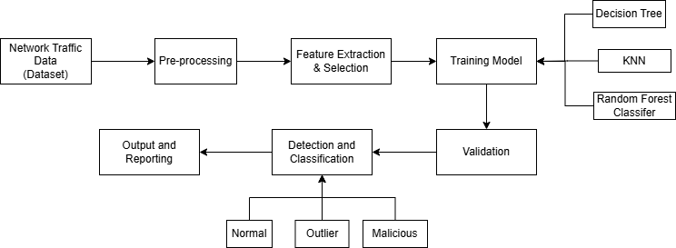
System Diagram
Logistic Regression

Slide 11
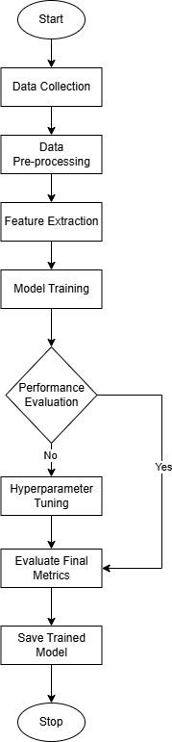
Model Training Flowchart

Slide 12
Modules Used in our system
We have used four modules in our system.
Data Processing Module
Data is cleaned and raw network traffic is prepared for analysis.
Module handles missing or inconsistent data.
Normalizing numerical features such as byte counts, and duration and removing irrelevant columns.
Feature Engineering Module
Extracting and selecting the most important feature for intrusion detection.
Extracting features like bytes_in, bytes_out, entropy, num_pkts_in, num_pkts_out.

Slide 13
Modules Used in our system contd.
3. Machine Learning Module
Machine learning algorithms are used to train models and evaluate machine learning models for detecting anomalies and intrusion.
Algorithm used: Random Forest, Decision Tree, Logistic Regression and K-Nearest Neighbors.
Detection and Reporting Module
A trained model differentiates network traffic and generates discrete results.
Classifying traffic into benign, outliner, or malicious classes.
Generating alerts or reports to identify threats.
Providing visualization of detection results.

Slide 14
System Evaluation
Precision: Ratio of true positive prediction to all positive prediction. It highlights the ability to minimize false positives.
Accuracy: It measures the ratio of correctly predicted instances to the total number of instances.
Recall: Ratio of true positive prediction to total actual positives (intrusions). It evaluates how well IDS detects actual intrusion.
F1-score: Harmonic mean of precision and recall, balancing both metrics. Formula: F1 = 2* (precision * recall)/(precision + recall).

Slide 15
Experiments, Result and Output

Slide 16
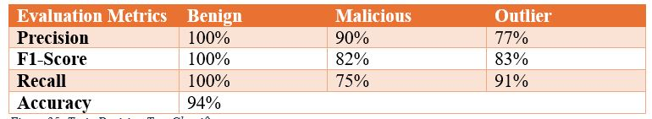
Experiment on LUFlow Dataset for 2022
Model | F1- Scores
Random Forest | 0.97
Decision Tree | 0.96
KNN | 0.89
Logistic Regression | 0.67

Slide 17
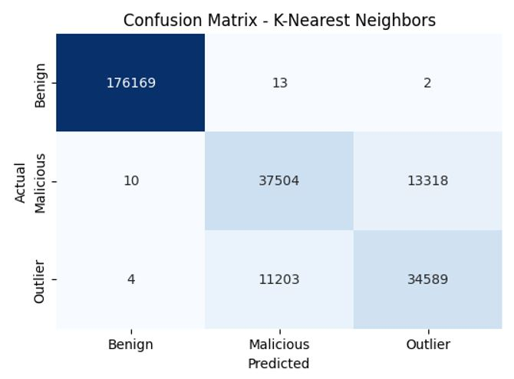
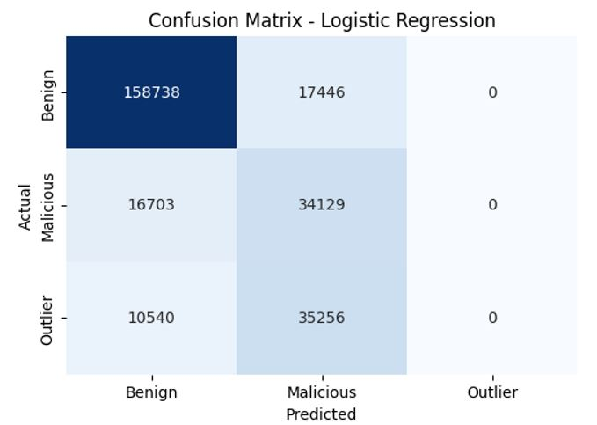
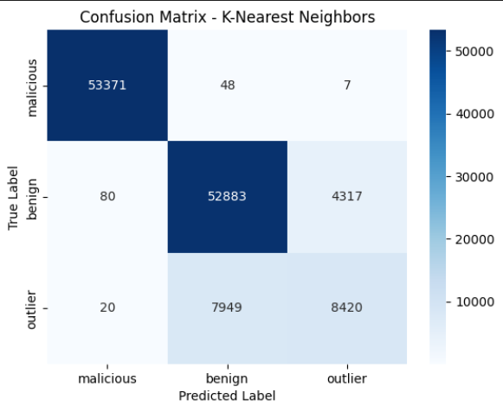
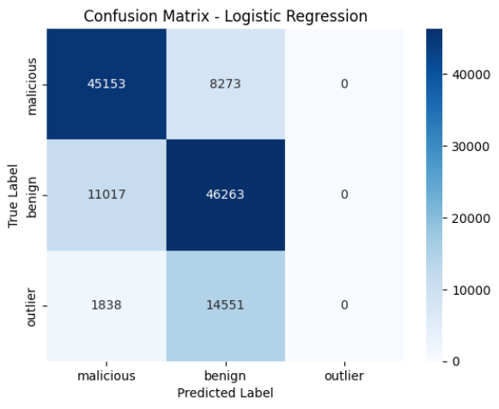
Confusion Matrix
K Neighbors Classifier
Logistic Regression

Slide 18
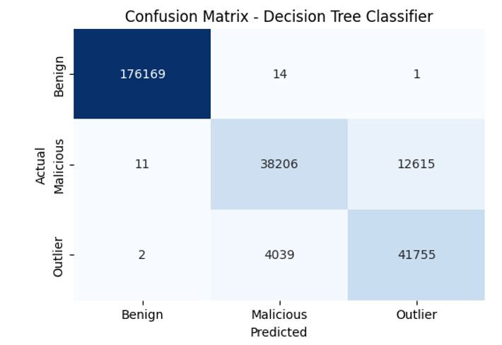
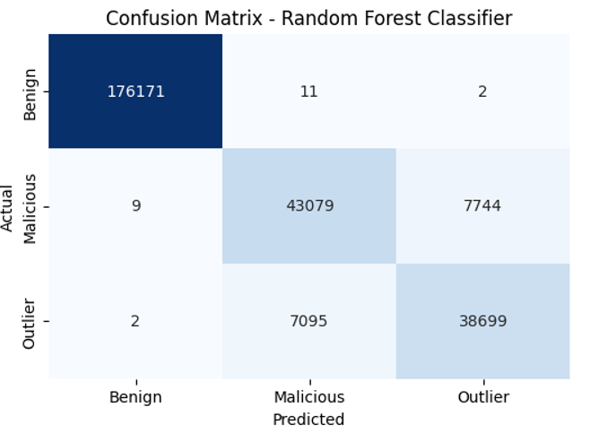
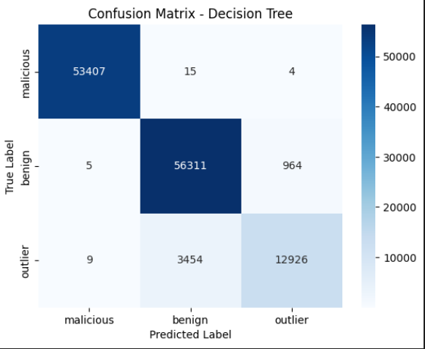
Confusion Matrix
Random Forest
Decision Tree Classifier

Slide 19
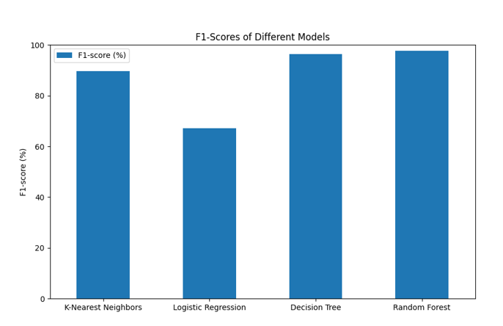
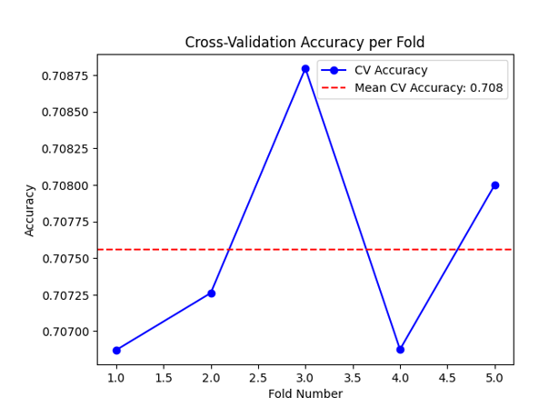
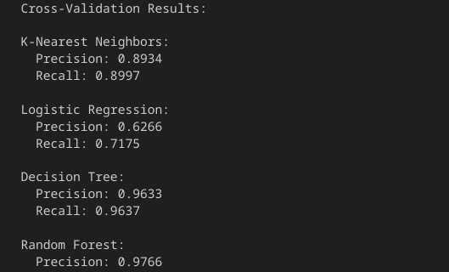
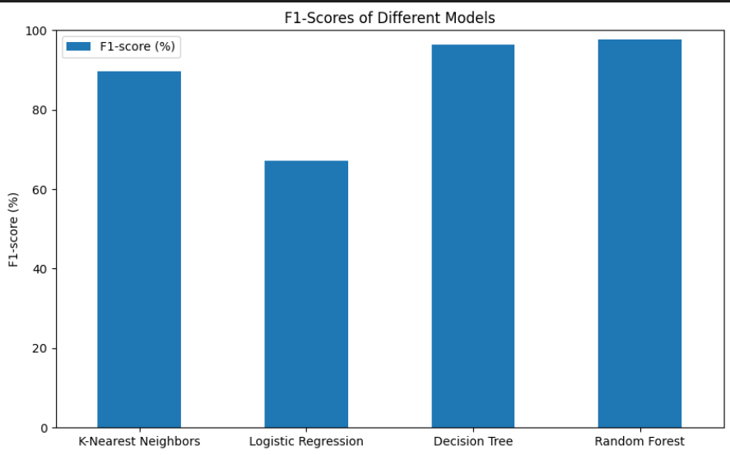
Cross Validation and F1 Score of Each Algorithm
Cross-validation Result
F1-Scores of Different Models

Slide 20
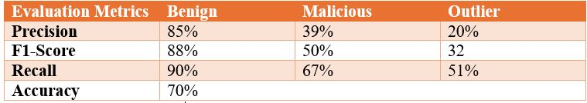
Performance Evaluation of Algorithm in LUFlow Dataset for 2022
Algorithm | Accuracy | Precision | F1-score | Recall
Random Forest | 97% | 97% | 97% | 97%
Decision Tree | 96% | 96% | 96% | 96%
KNN | 90% | 89% | 89% | 90%
Logistic Regression | 71% | 62% | 67% | 71%

Slide 21
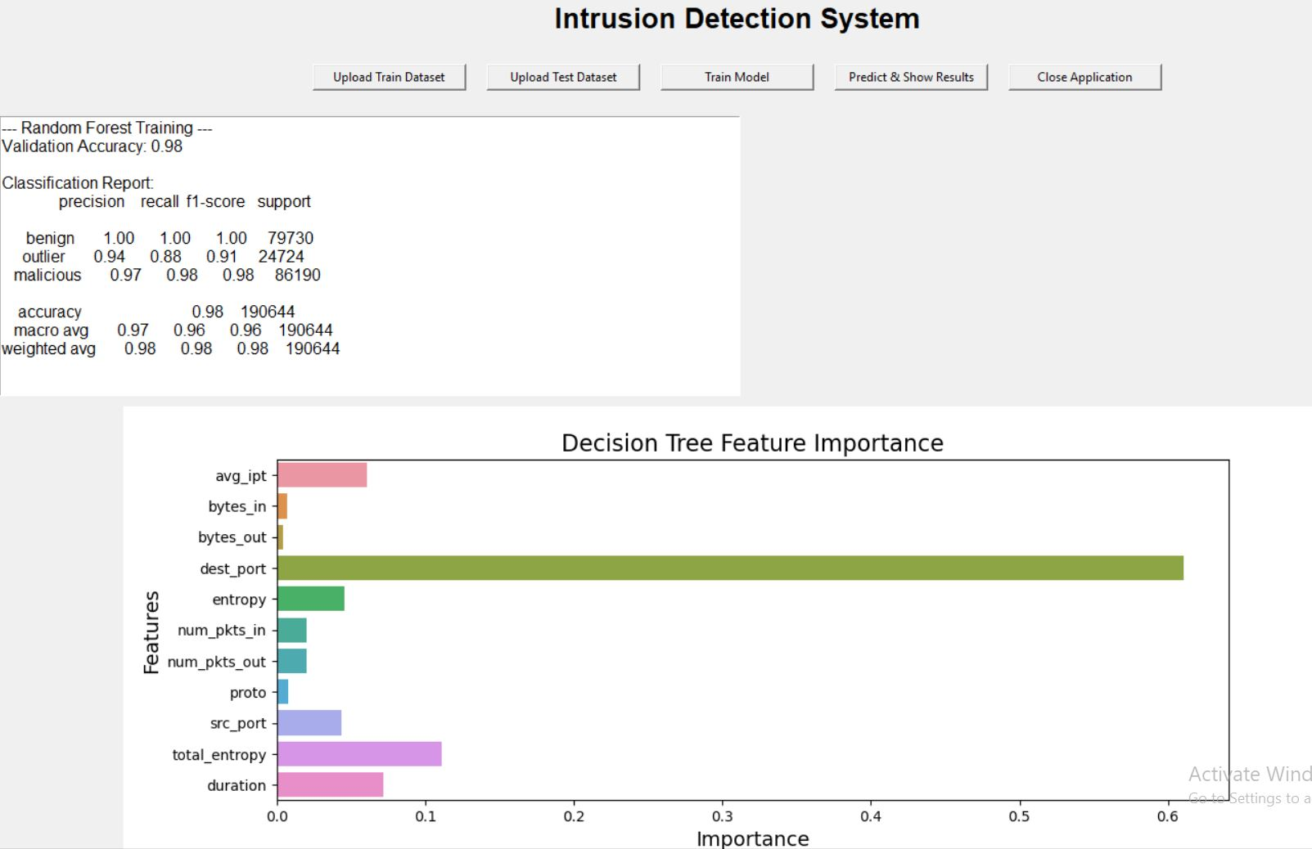
Sample Output

Slide 22
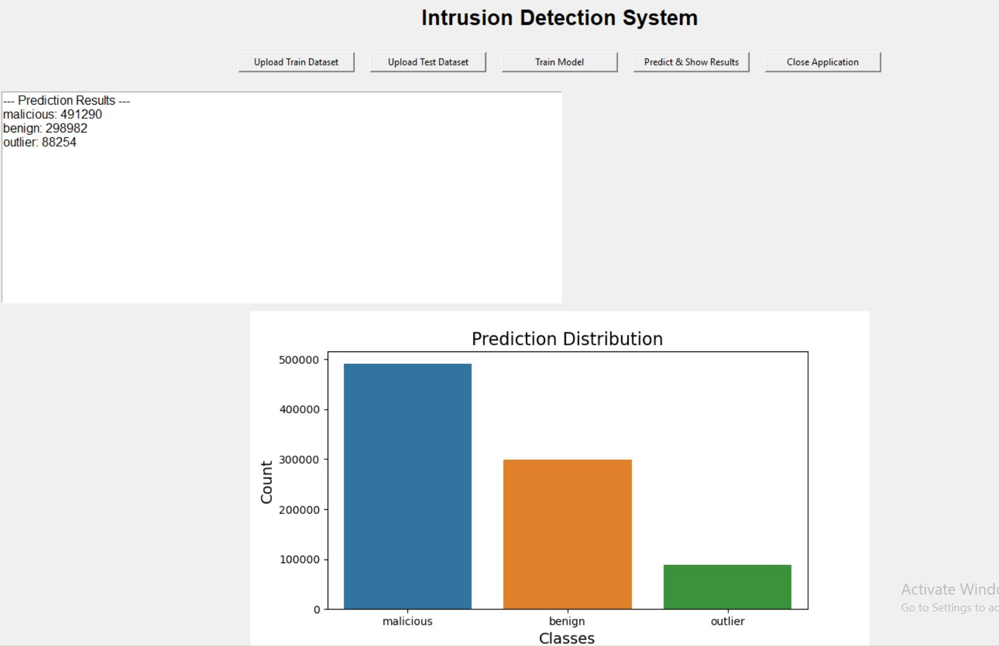
Sample Output: Result

Slide 23
Challenges and Limitations
Datasets often consist of fewer malicious, or outlier samples compared to normal samples which leads to biased model performance.
Despite many optimization attempts anomaly-based detection still produces false positives which can cause unnecessary alerts.
Monitoring and responding to real-time intrusion detection requires high computational power, which can be a hindrance in a limited resources environment.
Cyber threat patterns constantly evolve, making it challenging to maintain model functioning without constant updates and retraining.
Deploying systems in large-scale or high-traffic environments can raise challenges in scalability and efficiency.

Slide 24
Future Enhancements
Using deep learning techniques like neural networks to improve detection accuracy and handle complex network traffic patterns.
Improving the system to process and streamline data in real-time for immediate threat detection.
Combining signature-based, anomaly-based, and hybrid detection approaches for a robust intrusion detection framework.
Using methods like anonymization data to ensure secure and ethical handling of sensitive data.
Developing an interactive dashboard for visualizing detected intrusion, and system performance for easier monitoring.
Using an automation approach that detects and reports threats automatically without human intervention.
Using a diverse network environment to train a model to a wider range of attack patterns.
Optimize the system for large-scale environments or resource constrained without compromising accuracy and speed.

Slide 25
Conclusion
This project demonstrates the effectiveness of machine learning in building intrusion detection systems (IDS) to improve network security. Models like Random Forests, Logistic Regression, Decision Trees, and K-Nearest Neighbors achieved high accuracy in detecting and classifying network intrusion. Challenges such as handling imbalanced datasets and reducing false positives are handled efficiently. Overall, this work highlights the potential of machine learning to enhance cybersecurity and protect digital networks effectively.

Slide 26
Thank you

Slide 27
Any Questions??

